Slide 1
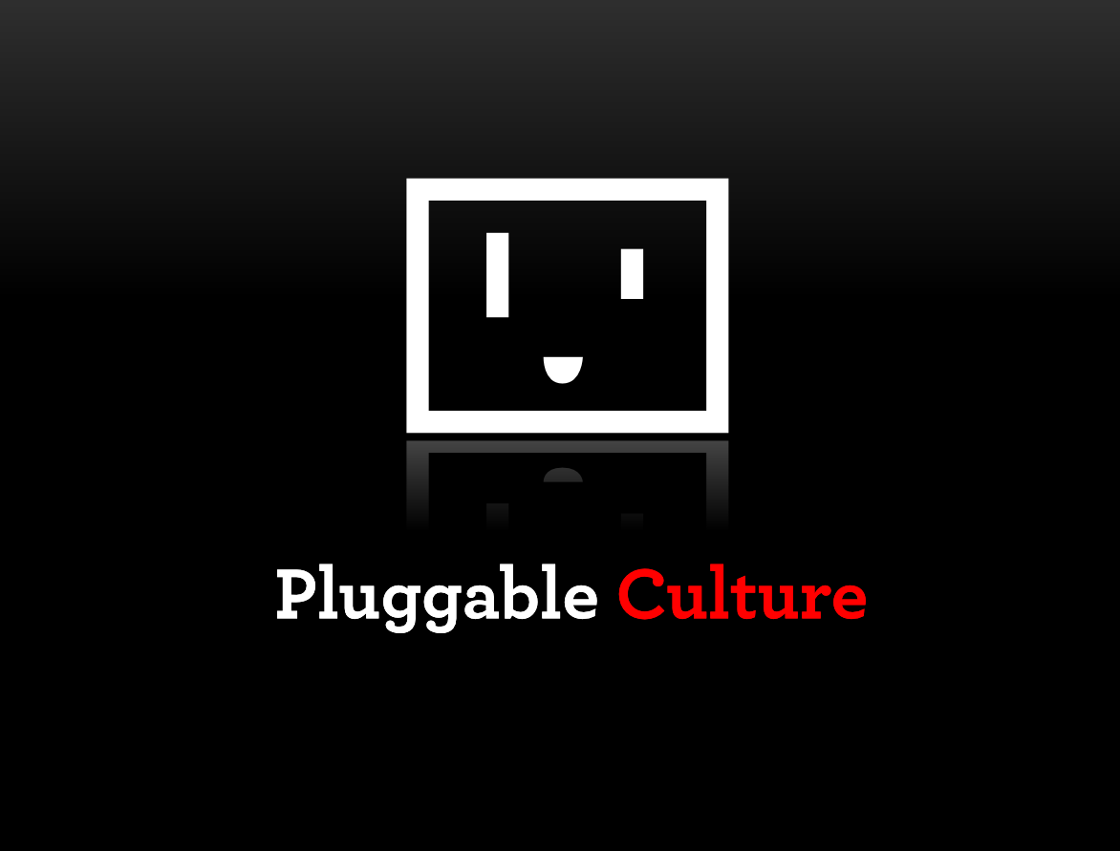

Slide 2
- Some framing (short version)
- Some practical bits
- Leave a few min for ?s

Slide 3
def. ‘a pluggable piece’: a complex tool with a simple interface that is explicitly designed be stacked and nested with other pluggable pieces to solve problems

Slide 4
…def ‘pluggable culture’: the resulting shift empowering more people to solve more specific problems on their own

Slide 5
inputs -> [ complexity ] -> outputs
Any ‘piece’ is,

Slide 6
I -> [C] -> O
I -> [C] -> O
I -> [C] -> O
I -> [C] -> O
I -> [C] -> O
solution!
I -> [C] -> O
I -> [C] -> O

Slide 7
… companies are starting to explicitly design towards producing ‘pluggable pieces’
Pieces have always existed, the shift is:

Slide 8
& this means that ‘pieces’ are explicitly designed to be ‘plugged’ not ‘hacked’
(back to this distinction in a sec)

Slide 9
In caveman times…. we made useful things all by ourselves from raw inputs
It was slow.

Slide 10
The march of the economy has been,
efficiency = f ( specialization ) = f ( communication technology )

Slide 11
Ask your typical 1776 pin maker…

Slide 12
-- 10 workers each making pins = 10 pins/day
-- 10 workers each making one part of each pin = 20 pins/day

Slide 13
more pins
- because each individual gets good at a slice of prod
-- because the other slices were abstracted
--- because the factory floor is a ‘local network’

Slide 14
Lots of great communications tech has driven more efficiency over the last 300+ years
social
search
internet
cell phone
jets
car
phone
telegraph
literacy
railroad
sanitation

Slide 15
but the insane acceleration in communication technology is just now morphing the equation:
efficiency = f ( specialization ) = f ( communication technology )

Slide 16
… because the primary mode of innovation was,
I want to provide something to a market,
So I need a ‘piece’
So I put out an RFP with a volume, the market provides

Slide 17
New ‘pieces’ were first made for a specific need, then abstracted or repurposed
The consumer wrote the spec

Slide 18
& hacking was picking up leftover pieces designed for one customer to do something new…

Slide 19
That type of ‘hacking’ is dying

Slide 20
… because the laws of efficiency under extreme communications environments tend towards pluggable pieces.

Slide 21
New ‘pieces’ are structured for the general case and then specified through additional layers
The producers write the spec

Slide 22
This is bottom up innovation vs. top down.

Slide 23
Practically speaking…

Slide 24
What is Pluggable Culture today?
Notes:
Grew out of a shift seen at NYCR and on the web
New tools empowering more people to do great stuff

Slide 25
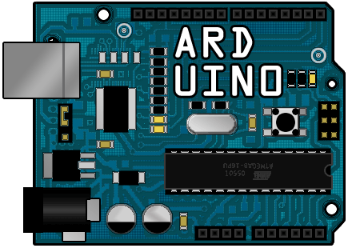



Open Source Hardware
Cloud Computing
Identity
Distribution
More…
io

Slide 26
Hardware
Notes:
Used to be:
Chips, programmers, EE knowledge
It was sort of a dark art

Slide 27
Ardunio open source microcontroller board
Makers
Artists
Open Source Feedback
Notes:
USB plug, pins for connecting sensors, leds, etc easily
Personal Robot arm story
Open source - Feedback loop helps it evolve

Slide 28
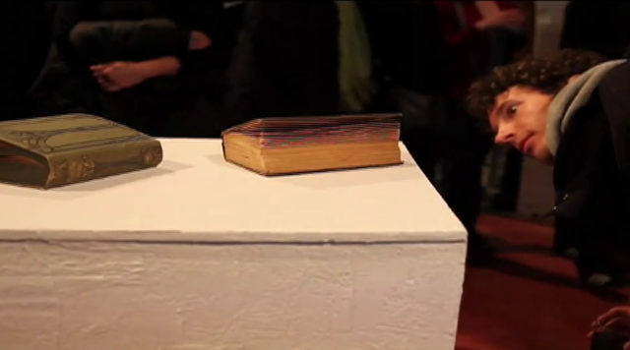

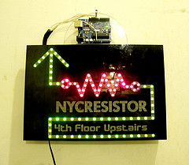
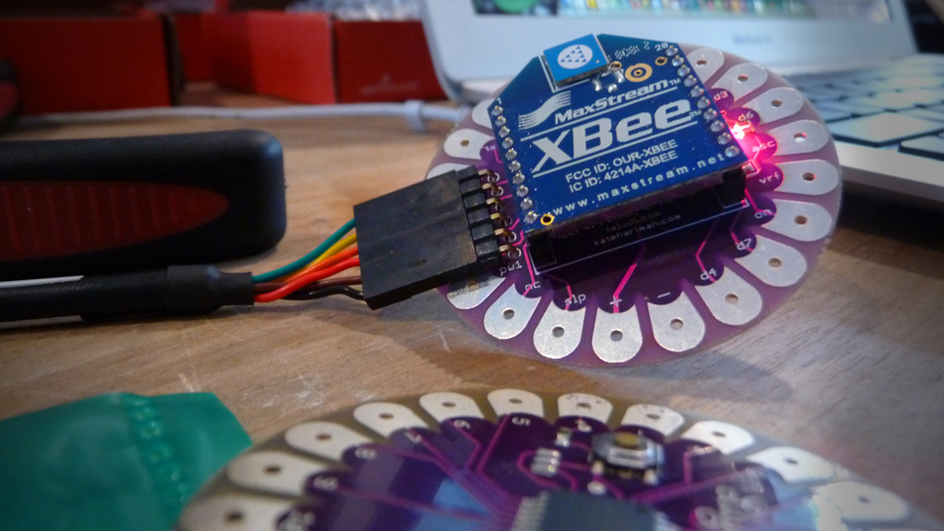
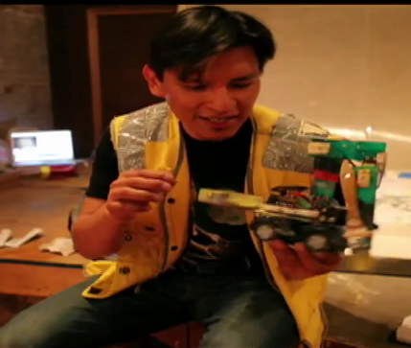

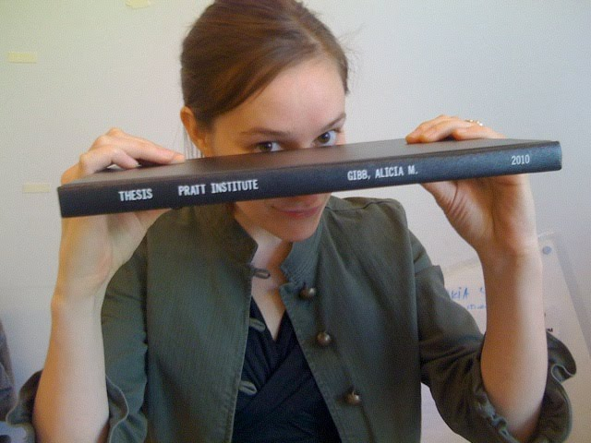
Arduino Powered Art
Interactivity without engineers
http://aliciagibb.com/thesis/
Notes:
Ardunio lets artists build in interactivity without engineers
Breathing bools, LED projects, painting robots
Lilypad in center
Alicia’s thesis
Good for artists, also great form makers

Slide 29
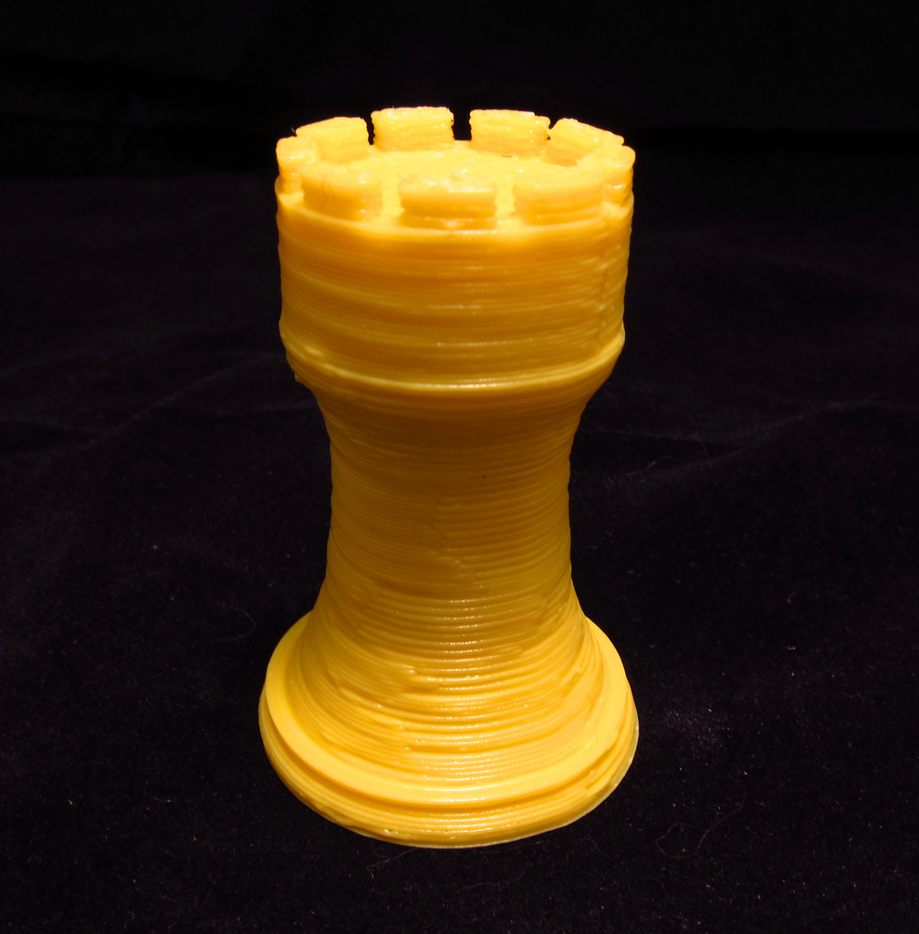
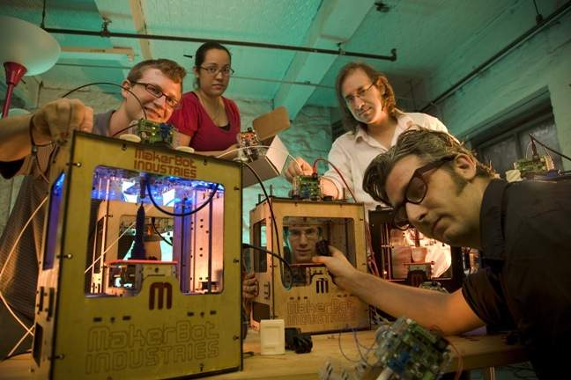
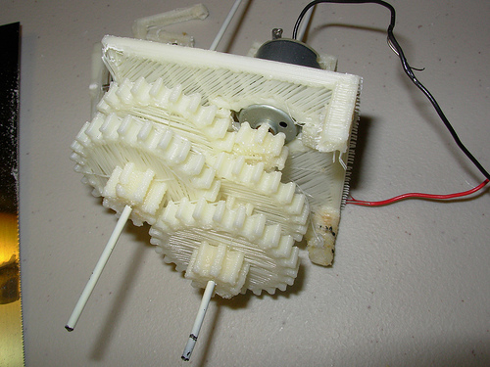
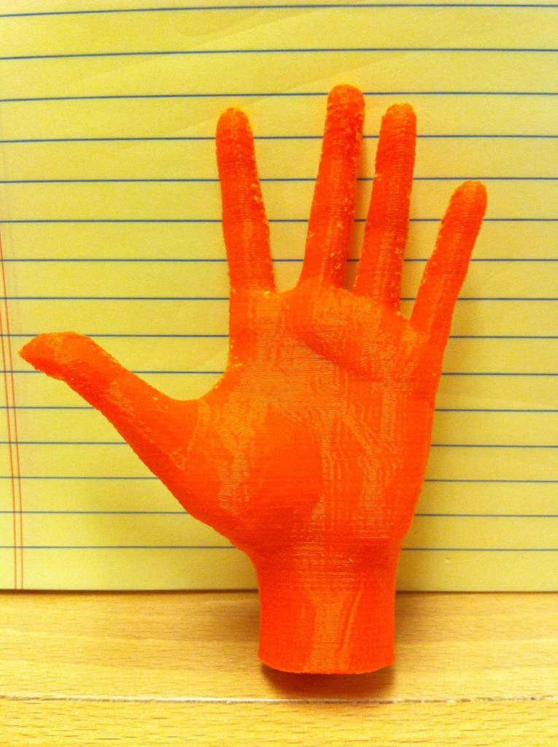
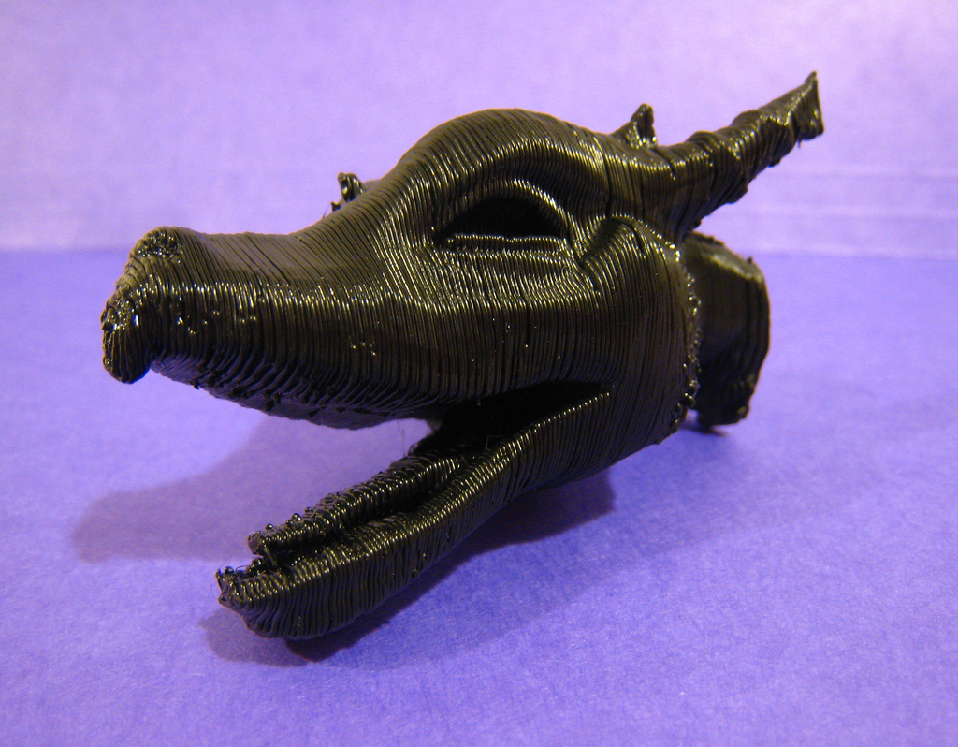
Makerbot open source 3D printer
Ardunio based
Founders are not engineers
Notes:
Started with ardunio, powers x/y/z, extruder
Not engineers

Slide 30
Cloud Computing
Notes:
You know cloud computing
But it’s interesting to frame it in that same story

Slide 31
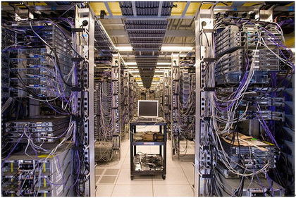
= Pluggable Computing
We used to run servers -
Now we run software.
AWS & others give us:
Abstraction, scalability, reliability, pluggability
Pluggability = More Diversity
Notes:
Old days – hardware, servers etc
Now we run software
Abstraction, scalability, reliability, pluggablility
Because it’s pluggable, others can expose same
Simple interface
It commoditizes hosting & the niche skills

Slide 32
That's still hardware

Slide 33
Pluggability is moving up the stack
Pluggable APIs for complex pieces
of your application
Open Source Application Frameworks
Open Source Software / web servers
Abstracted Hardware

Slide 34
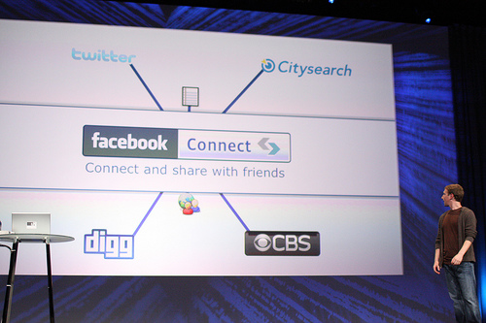
Pluggable Identity
Notes:
3 years ago…
Had to make user class
Strong argument for plugging in FBC and
Getting users data, connections, etc

Slide 35
Pluggable Distribution
Notes:
The big bird in the room
You used to have to deal with email, seo & more to attempt to get your users to share
Now you can plug in twitter, and distribute to your users networks

Slide 36
Powerful, complex functionality with a simple API

Slide 37
More & more functionaliy is sharding into pluggable pieces

Slide 38
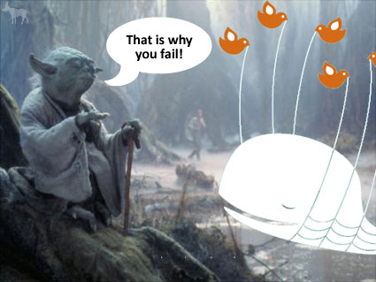
Pluggable Problems?
Notes:
That’s not to say there aren’t problems…
But in many cases the pros of pluggability outweigh them

Slide 39
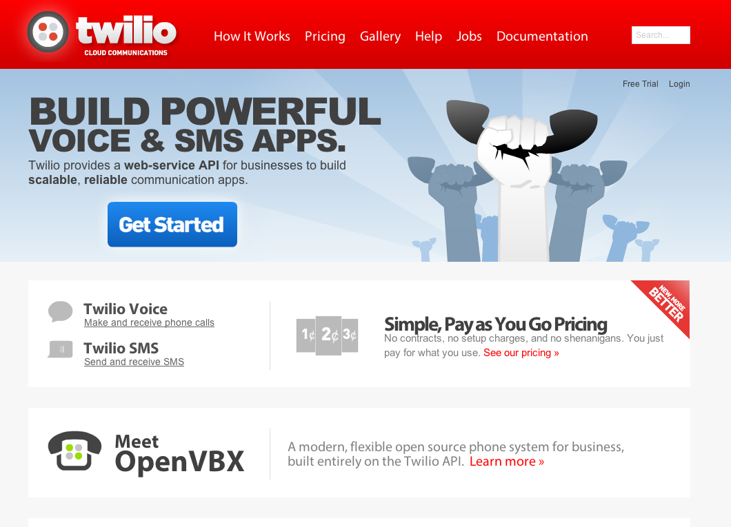
Pluggable Telephony

Slide 40
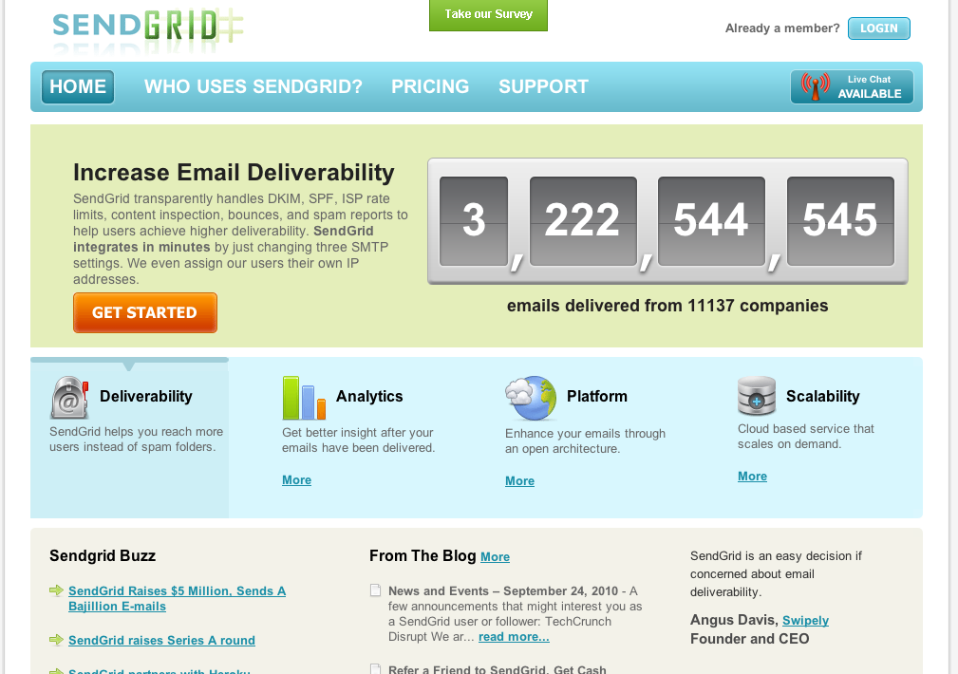
Pluggable Deliverability

Slide 41
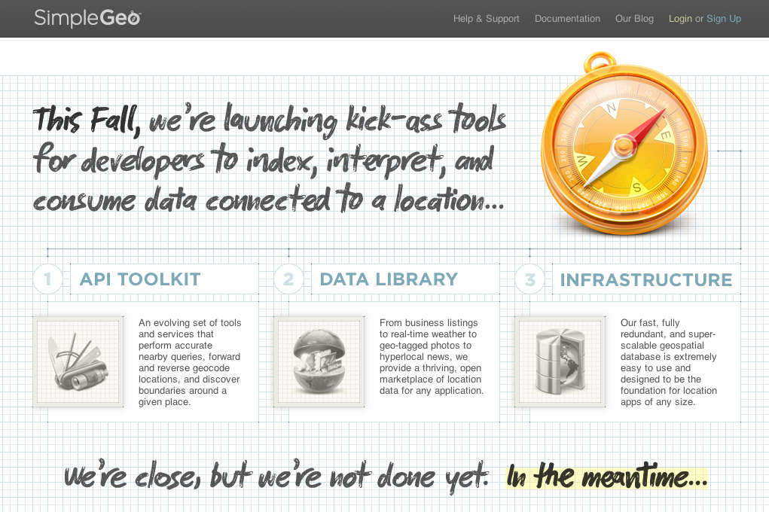
Pluggable Location

Slide 42
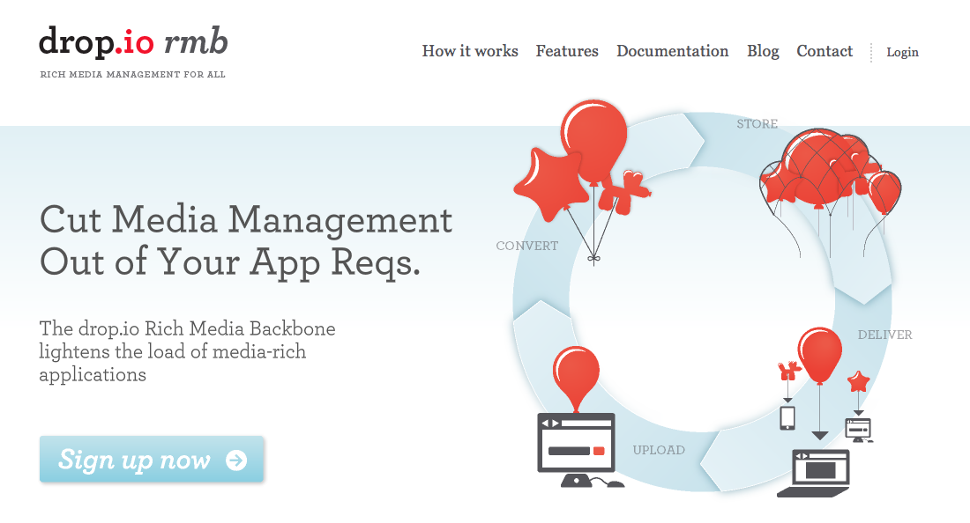
Pluggable Files

Slide 43
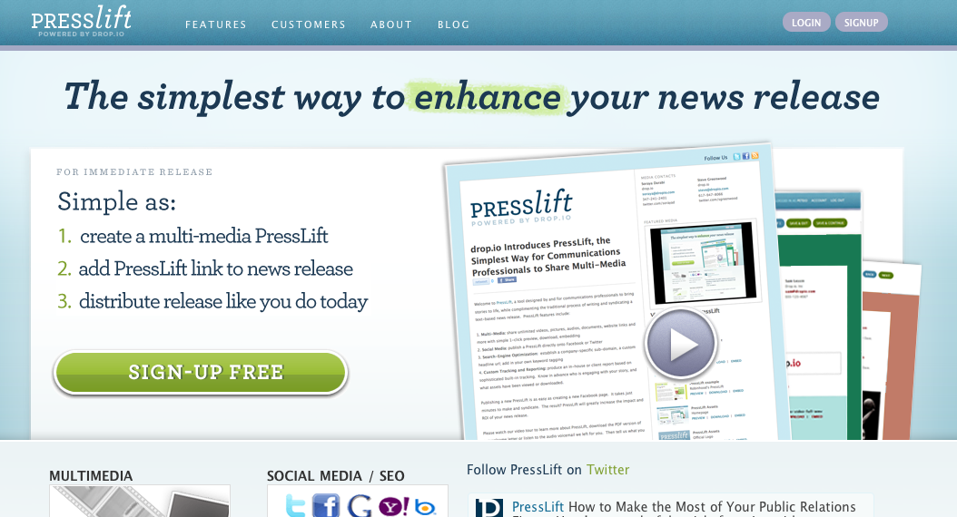
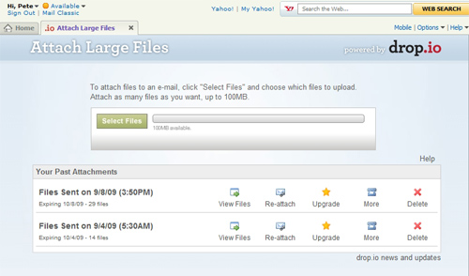
Abstract it out, and build faster
presslift
Y! Mail Attach Large Files

Slide 44
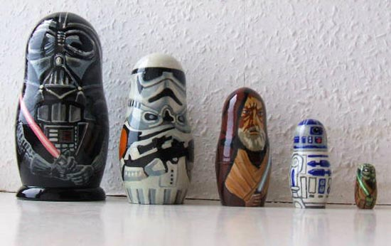
Pluggable Pieces nest and stack
Open source
software
Application
Frameworks
Drop.io
presslift
Amazon AWS

Slide 45
Building an app has changed.

Slide 46
Younger developers are learning the pieces, and how to plug them together

Slide 47
Start plugging in pieces, and get on with developing the fun stuff

Slide 48
PluggableCulture.com
@ericskiff
@lessin

